Slide 1
B4W_BB8:
A Ball-Shaped Self-Propelling Smart System

Slide 2


Slide 3
B4W_BB8:
A Ball-Shaped Self-Propelling Smart System
Enabling intruder detection and environment monitoring in remote areas

Slide 4
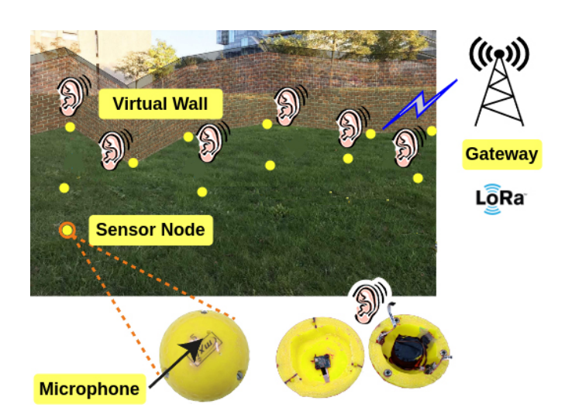
Background: Balls for Walls
Movement?

Slide 5
Requirements
RQ1 The system should be able to navigate to a given location.
RQ1.1 It should be possible to set a target through a base station.
RQ1.2 The system should roll from its current location to a given point B without any additional assistance.
RQ2 Get real-time feedback from any sensors on a base station.
RQ2.1 Wireless communication should be possible from a suitable range.
RQ2.2 Sensor data should be sent at speeds of at least 1Hz.
RQ3 Be expandable with different types of sensors
RQ4 Be as small as possible

Slide 6
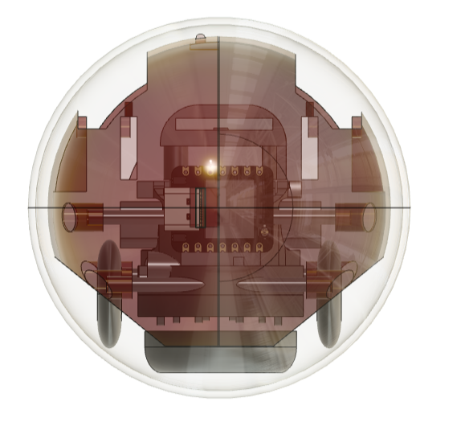
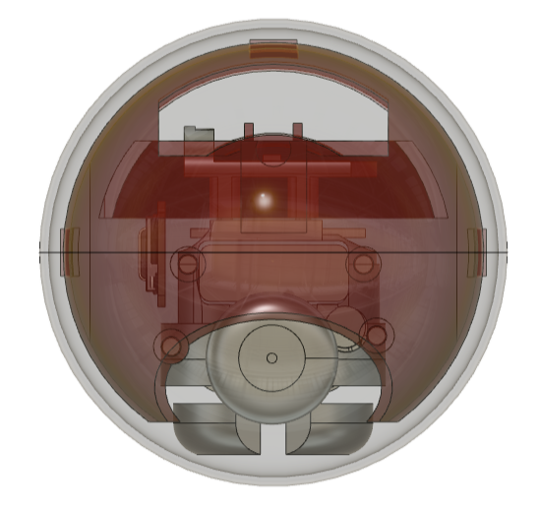
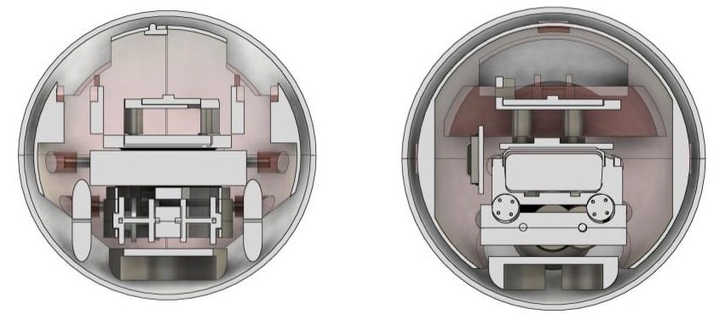
Hardware Design

Slide 7
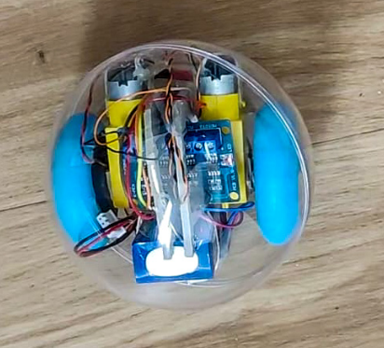
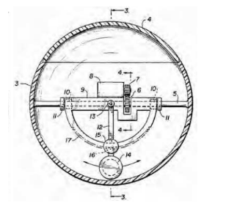
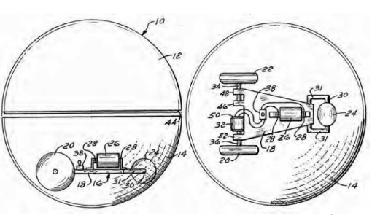
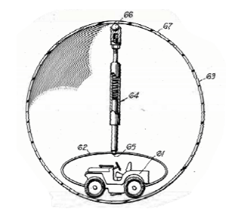
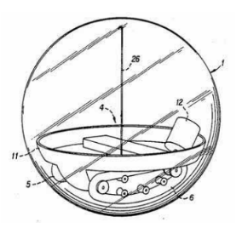
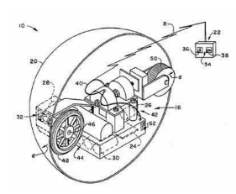
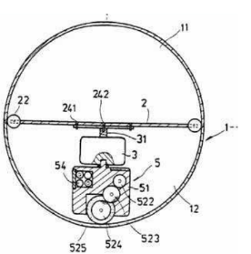
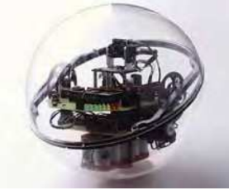
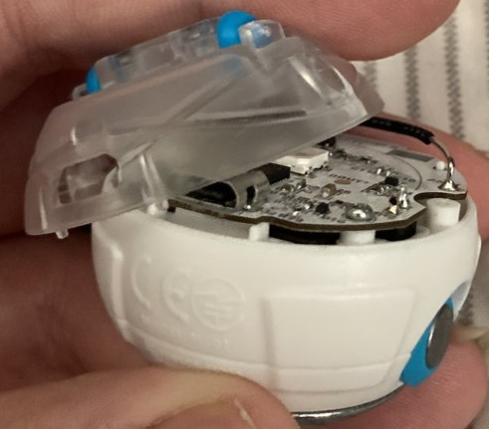
Hardware Design
Friction wheels

Slide 8
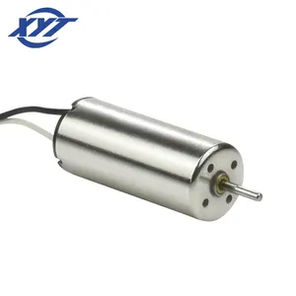
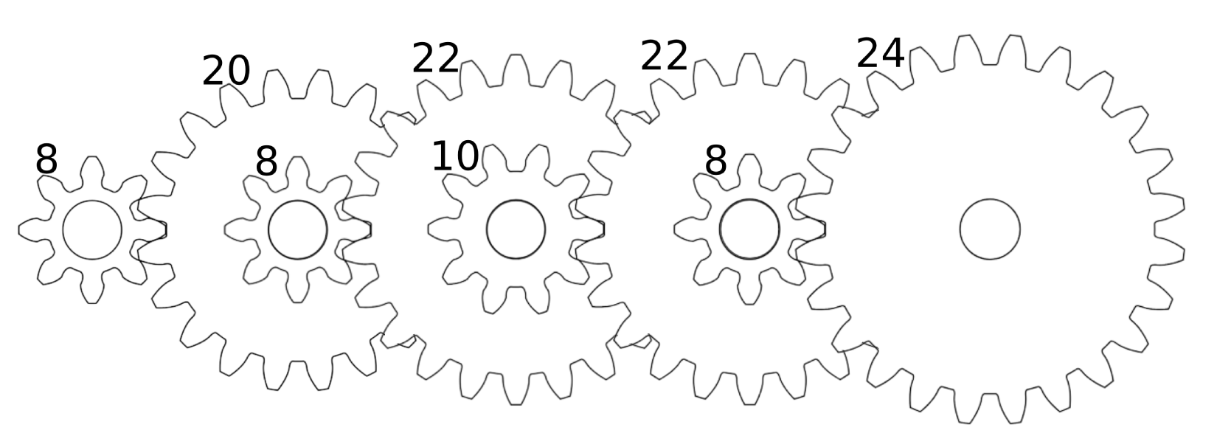
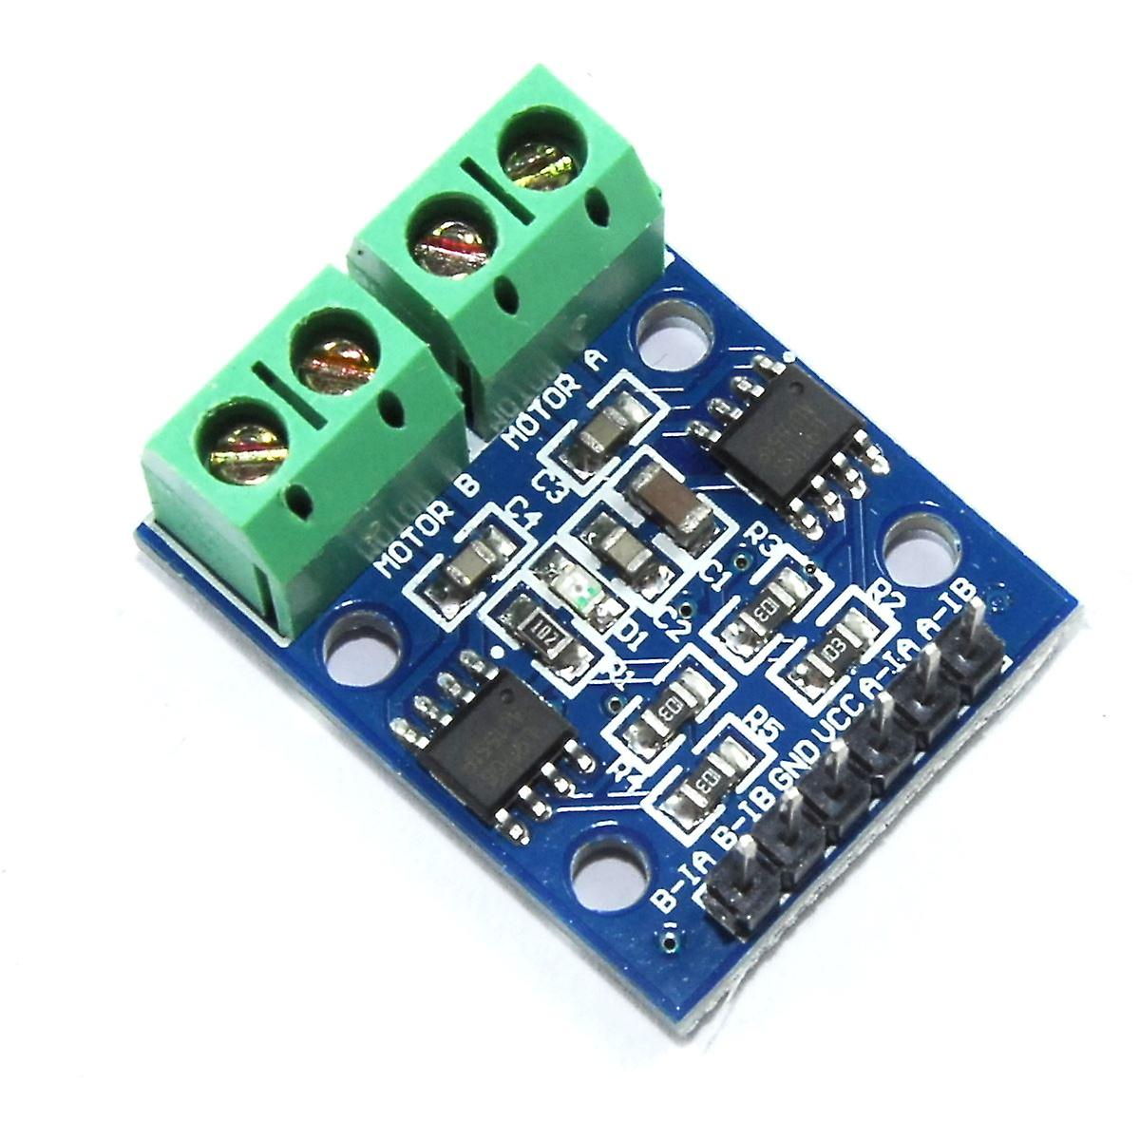
Hardware Design
Coreless motors
1:44
Gear &
Motor System
Notes:
Coreless motors: high power-to-weight ratio, high efficiency and
high acceleration and deceleration rate

Slide 9
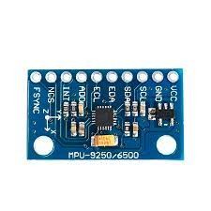
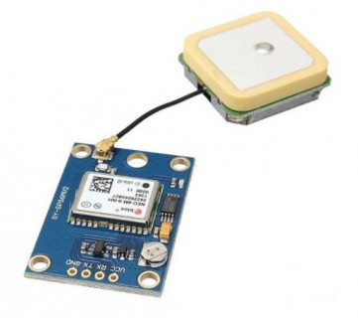
Hardware Design
GPS
IMU
IMU: Gyroscope, Magnetometer, Accelerometer
Notes:
Coreless motors: high power-to-weight ratio, high efficiency and
high acceleration and deceleration rate

Slide 10
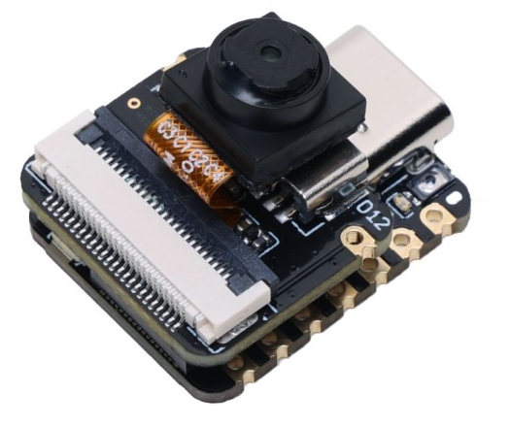
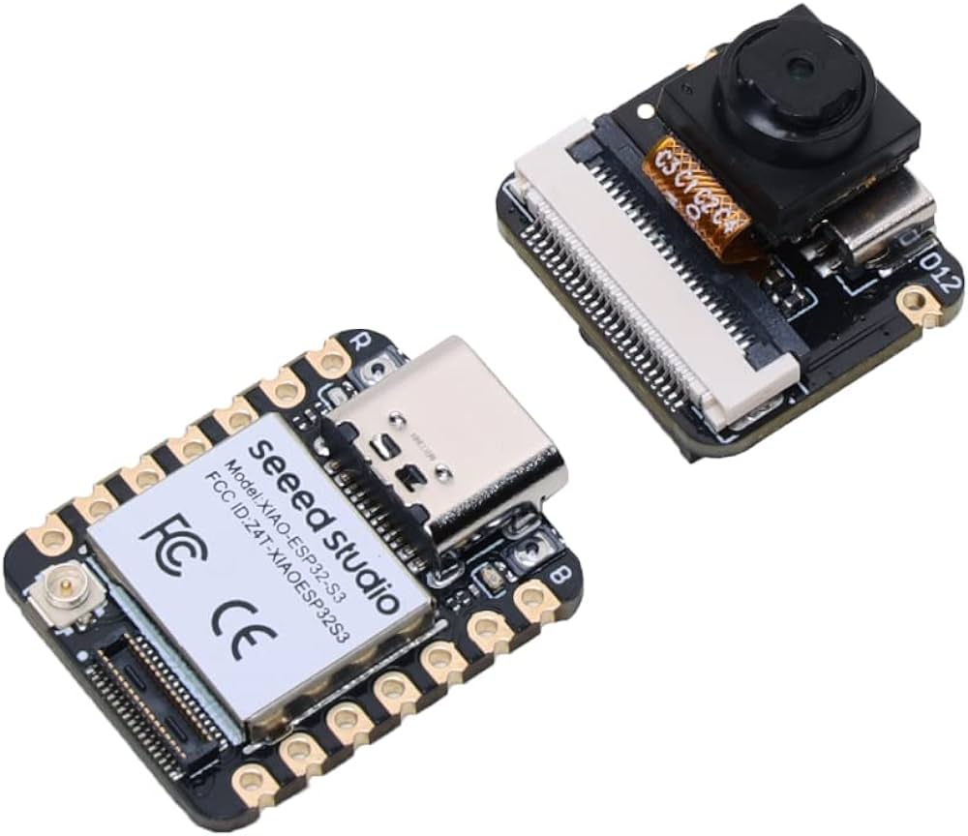
Hardware Design
Microcontroller XIAO-ESP32-S3
Notes:
Coreless motors: high power-to-weight ratio, high efficiency and
high acceleration and deceleration rate

Slide 11
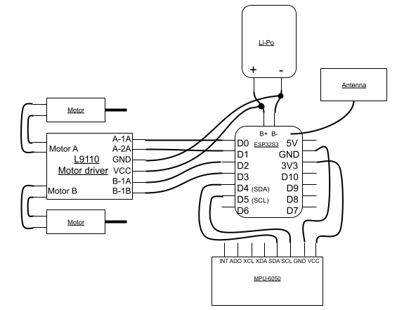
Hardware Design
Notes:
Coreless motors: high power-to-weight ratio, high efficiency and
high acceleration and deceleration rate

Slide 12
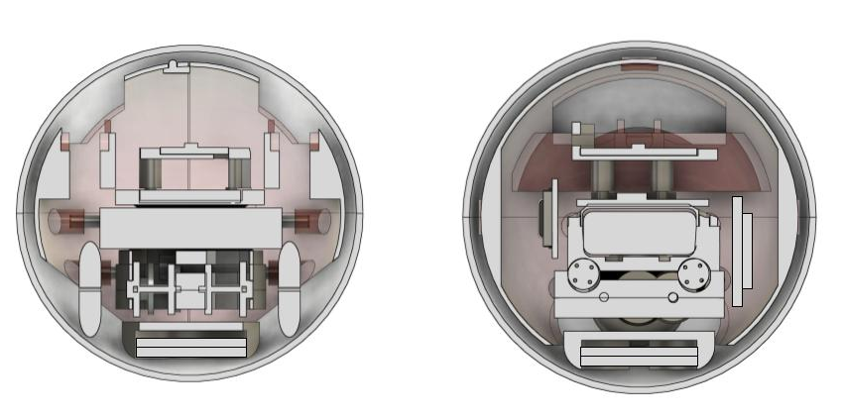
Hardware Design
Weights
Notes:
17.32g & 21.5g
high acceleration and deceleration rate

Slide 13
Hardware Design
Outer shell
Inner shell
Frame
Notes:
17.32g & 21.5g
high acceleration and deceleration rate

Slide 14
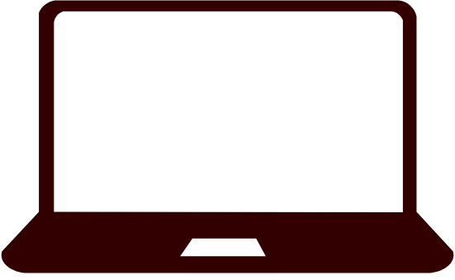
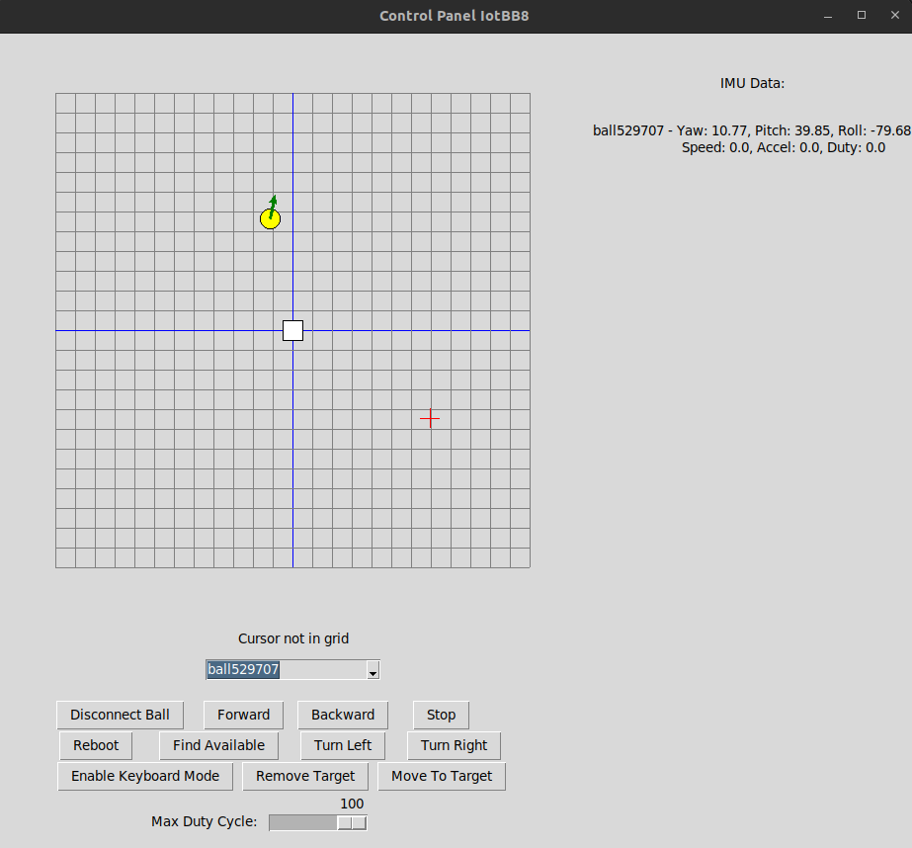
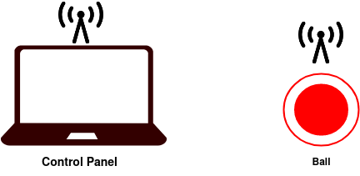
Software Design - Control Panel
IMU Data
Ball location and orientation
Target selection
Currently selected ball
Control buttons

Slide 15

Software Design - Connecting to Control Panel
State of Ball
Objective: Init
Action: None
MQTT: register 101456
(2) Broadcast ID to control panel(s) [Topic = Register]
(3) Register ball to GUI
ID: ball101456
(4) Optionally: Find available mode to re-register
(1) Generate unique ID

Slide 16
Software Design - Connecting to Control Panel
(3) Register ball to GUI
Software Design - Initialization Process
State of Ball
State of Ball
State: Init
Action: None
State: Init
Action: None
(2) Send Init objective message to ball
State of Ball
Objective: Init
Action: None
State of Ball
Objective: Idle
Action: None
MQTT: ball101456/objective IN -20.0 50.0
(2) Send Init objective message to ball
Initial Pos: X: -20.0 , Y: 50.0
(3) Process Init objective
(1) Select initial position
(4) Transition to Idle state

Slide 17
Software Design - Connecting to Control Panel
(3) Register ball to GUI
Software Design - Status Message
(2) Send Init objective message to ball
State of Ball
Objective: Idle
Action: None
(3) Send state message
State Message:
Current Action
Current Objective
Position (x, y)
Pitch
Roll
Heading
Speed
Acceleration
Duty Cycle
Total Displacement
MQTT: ball101456/state <state array>
(2) Create state message from state machine of ball (every 1000 ms)
(4) Display current status
(1) Process internal state in decision loop (every 50 ms)

Slide 18
Software Design - Connecting to Control Panel
(3) Register ball to GUI
Example: Forward 46
Example: Forward 46
Software Design - Objective Handler
Example: Forward 46
Example: Forward 46
State of Ball
Objective: Idle
Action: None
State of Ball
Objective: MT
Action: None
State of Ball
Objective: MT
Action: TurnLeft
MQTT: ball101456/objective MT 90.0 -10.0 46
(2) Send new objective
(3) Process new objective in objective handler
(4) Gracefully finish old objective and determine new action for reaching objective
Example: Move To X: 90.0, Y: -10.0,
Max Duty Cycle: 46
(1) Select objective & max duty cycle
(5) Action handler executes next action

Slide 19
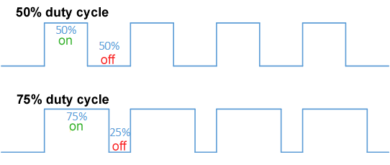
Software Design - Connecting to Control Panel
(3) Register ball to GUI
Software Design - Action Handler & State Update
State of Ball
Objective: MT
Action: TurnLeft
(3) Primitive actions directly control motor driver via specific PWM signal patterns
State of Ball
Objective: MT
Action: Forward
(2) Action logic defined for primitive actions:
Forward, Backward, TurnLeft, TurnRight, Stop
(4) Read IMU and update internal state machine for next decision interval
(1) Action handler executes next action
(5) Objective handler re-evaluates state and determines next action for action handler

Slide 20

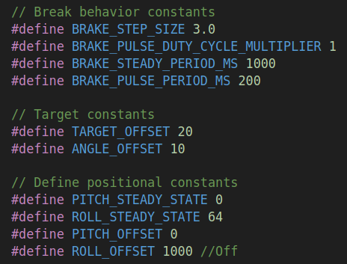
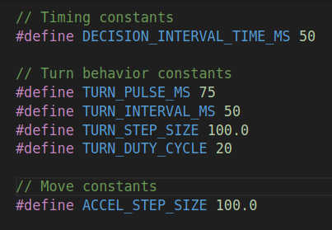
Software Design - Behind the scenes
(1) Technology Stack
(1) Technology Stack
Move To
Calculate angle to the target:
If angle small enough, move forward towards target
Else, turn left/right to decrease angle to target
Calculate distance to target:
If close enough to target, stop and set the objective to Idle
Else, repeat cycle
Forward & Backward
Increase duty cycles stepwise until target duty cycle is reached
Send adjusted duty cycle to motor driver through pwm_forward or pwm_backward for both motors.
Update internal state accordingly.
TurnLeft & TurnRight
Increase duty cycles stepwise until target duty cycle is reached
Turns are defined in pulses:
Waiting phase
Pulse phase
In pulse phase, send adjusted duty cycle to motor driver through pwm_forward and pwm_backward where both motors receive opposite directions.
Update internal state accordingly.
Stop
Decrease duty cycles stepwise until duty cycles is 0.
Send adjusted duty cycle to motor driver through pwm_forward or pwm_backward to slow down the current action gradually.
[Optionally] If roll exceeds threshold during stop action provide a counter-directional pulse to prevent tilting.
Update internal state accordingly.
ESP-IDF Framework
C Programming Language
FreeRTOS
MQTT for Application Data
MCPWM Motor Driver
Control Panel: Python 3.10 & Tkinter
IMU Processing
AHRS Filter
Gravity compensation
Velocity & Displacement estimation by integrating over the acceleration data
Improve estimation by fitting a model of the real-world displacement to the estimation of the device
(2) Configuration Options
(2) Configuration Options
(3) IMU Processing
(3) IMU Processing
(4) Action Implementation
(4) Action Implementation
(5) Move To Implementation
(5) Move To Implementation

Slide 21
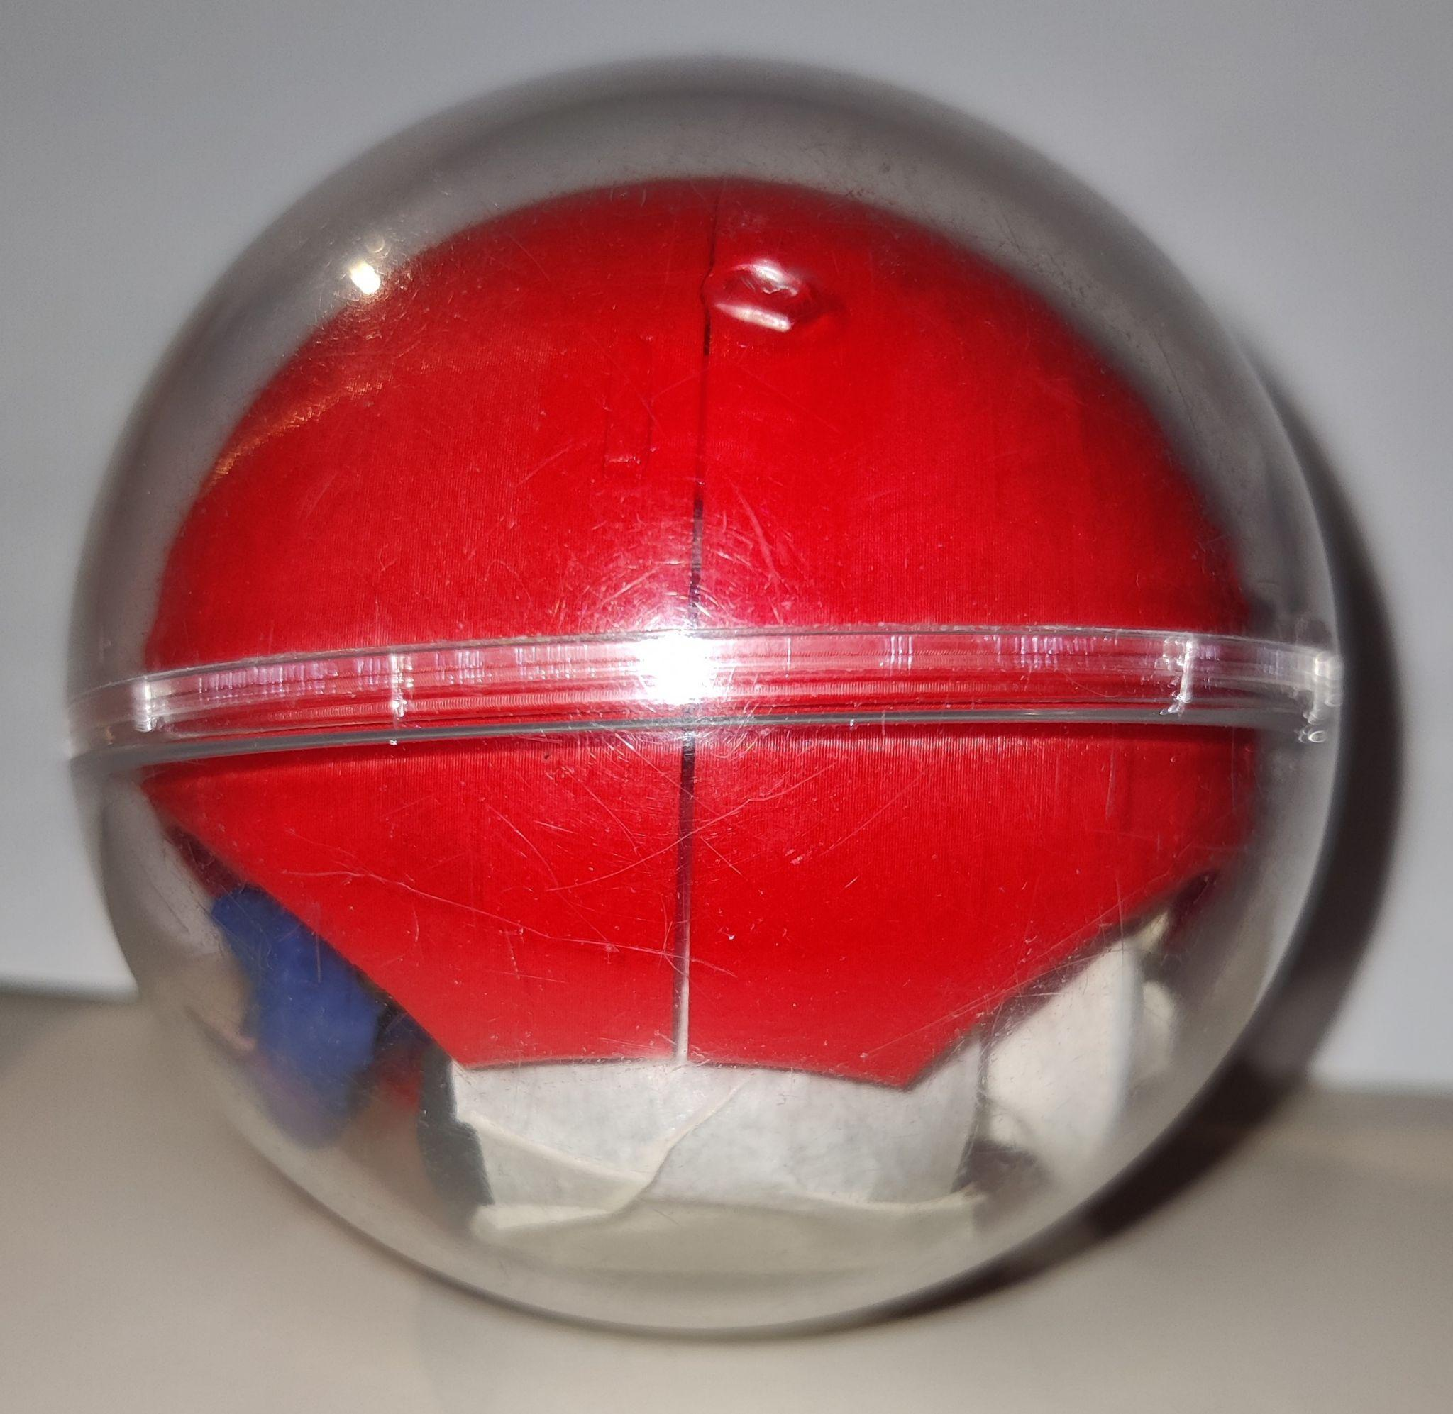
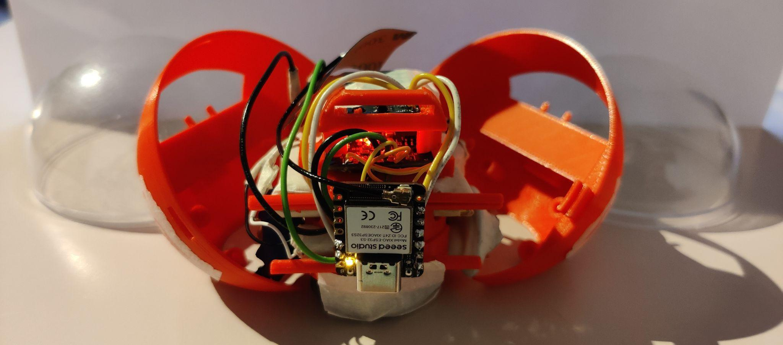
Final prototype

Slide 22
Experiments
Plastic flooring
46% duty cycle
Steady state 26 degrees from horizontal
Allowed target offset 20cm
Allowed angle difference 5 degrees
500ms stabilization

Slide 23
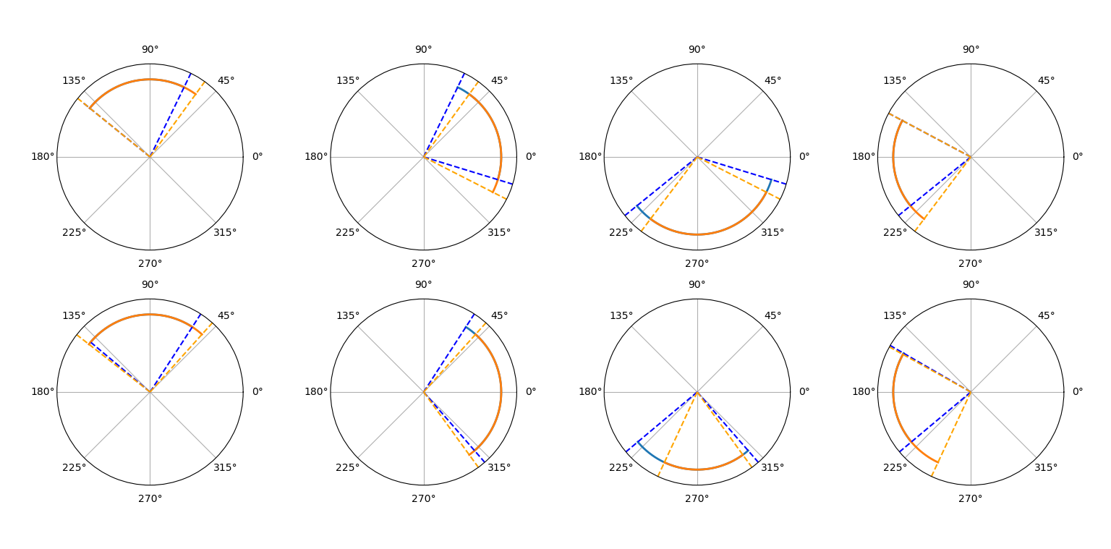

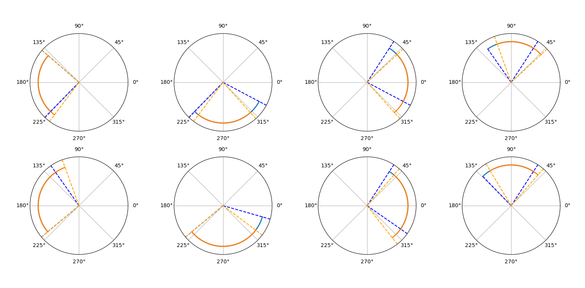
Experiments:
Angle readout
verification
Clockwise maximum difference
19 degrees
Counterclockwise maximum difference
25 degrees
Error accumulation
Magnetic interference

Slide 24
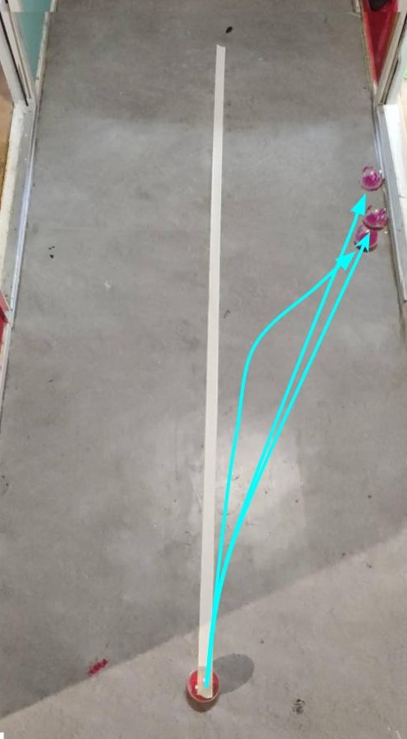
Experiments:
Straight line divergence

Slide 25
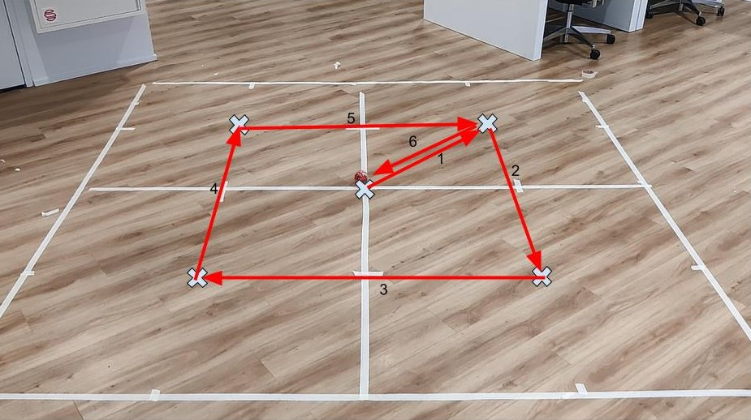
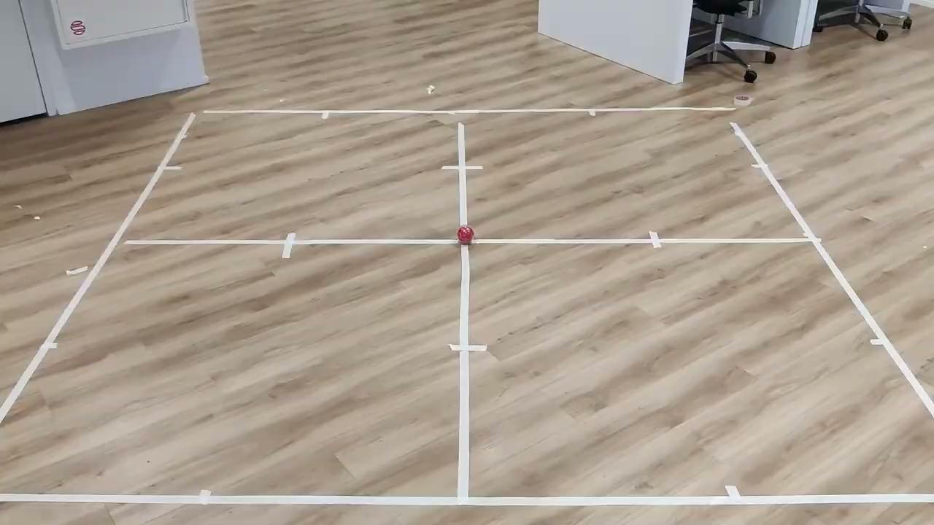
Experiments: Navigation accuracy

Slide 26
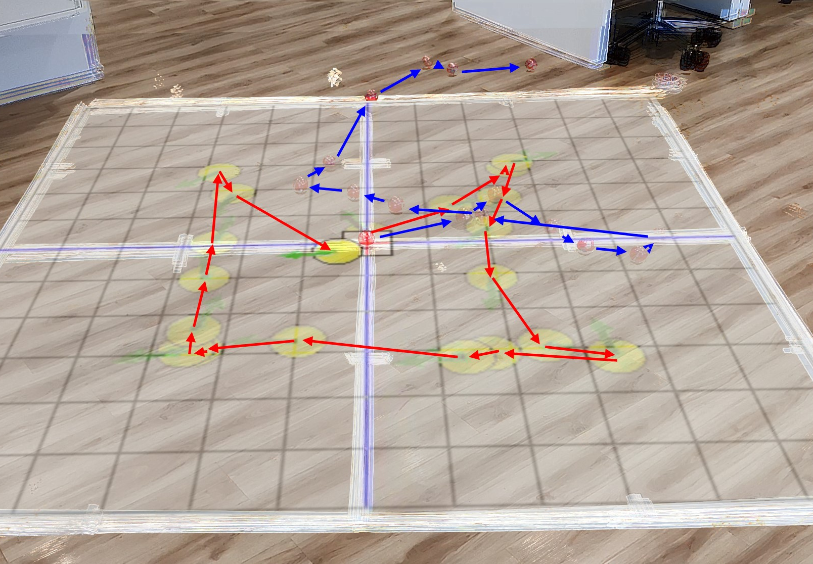
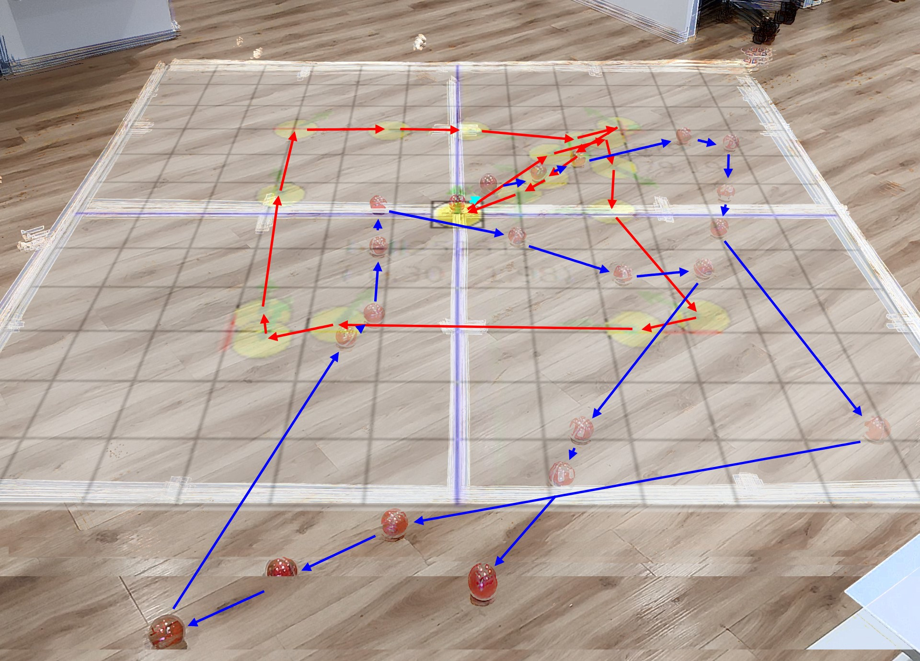
Experiments: Navigation accuracy

Slide 27
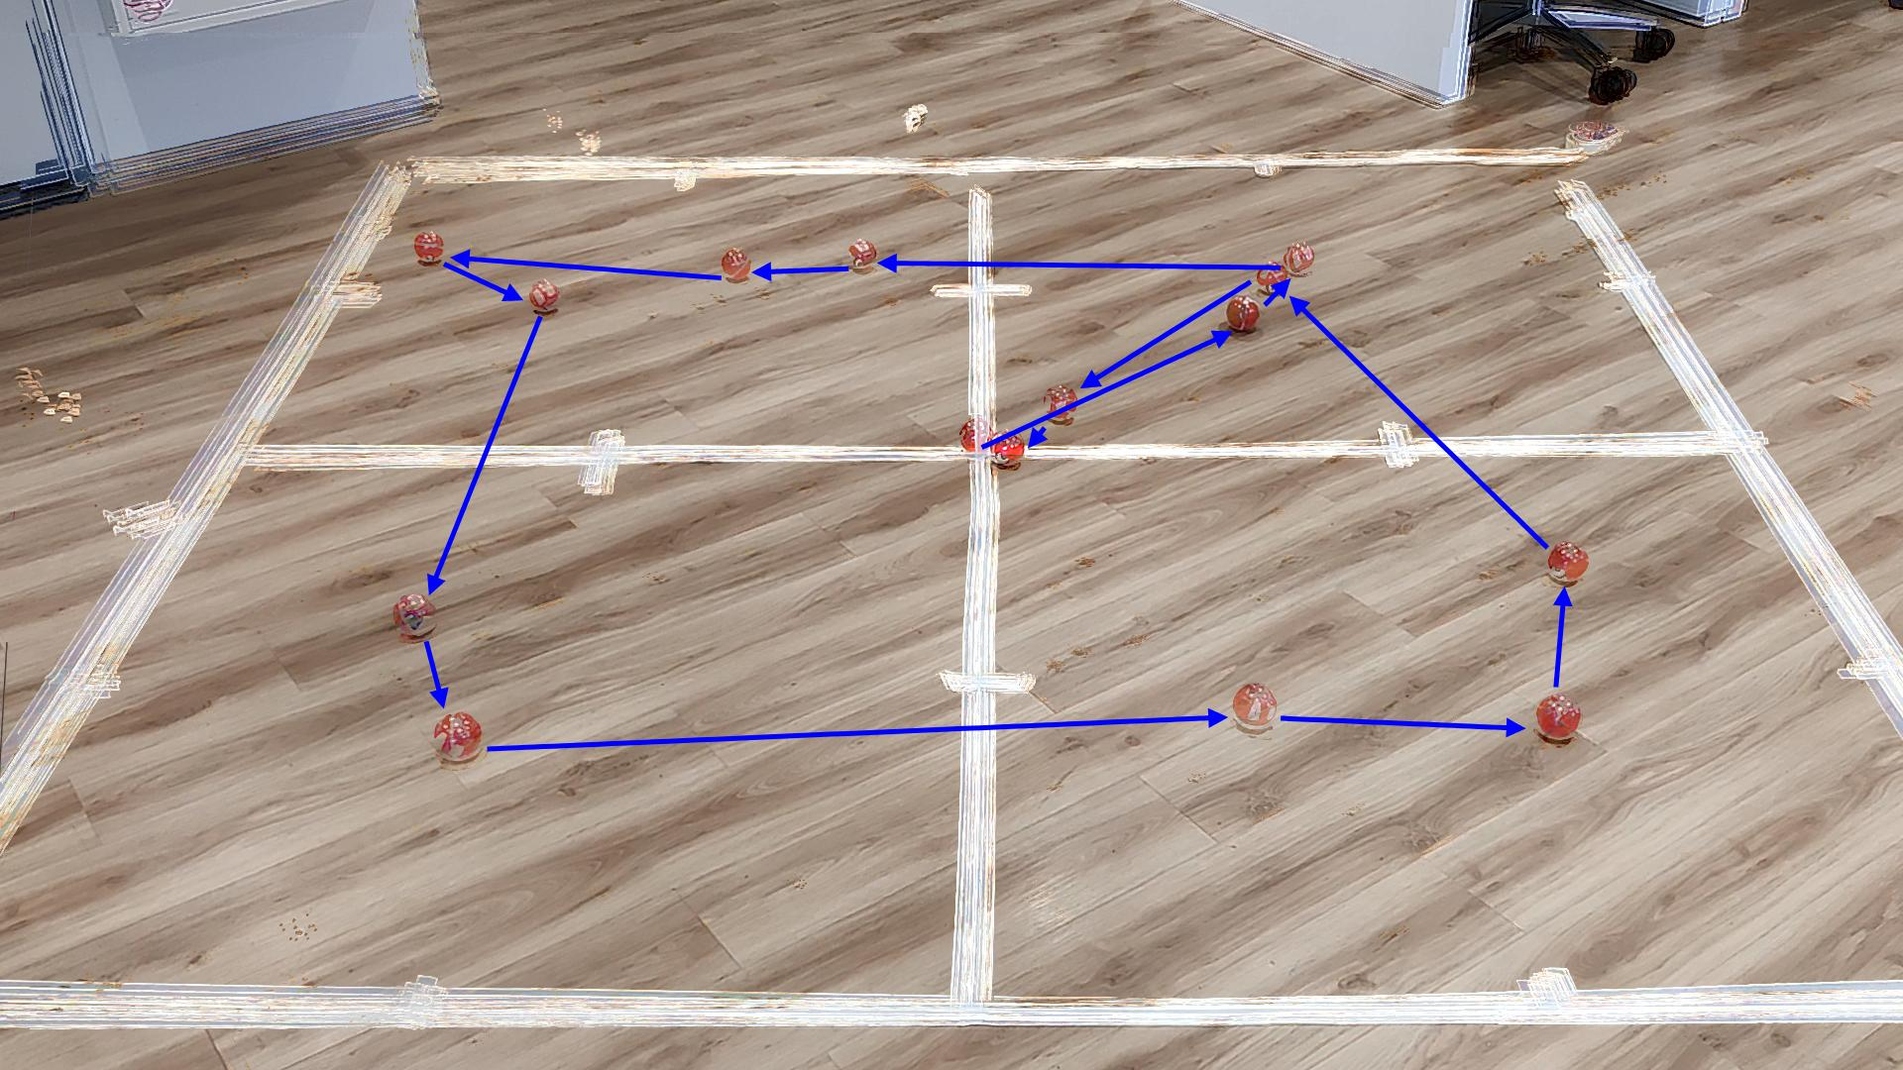
Experiments: Controllability test

Slide 28

Experiments: Inclined surface test

Slide 29
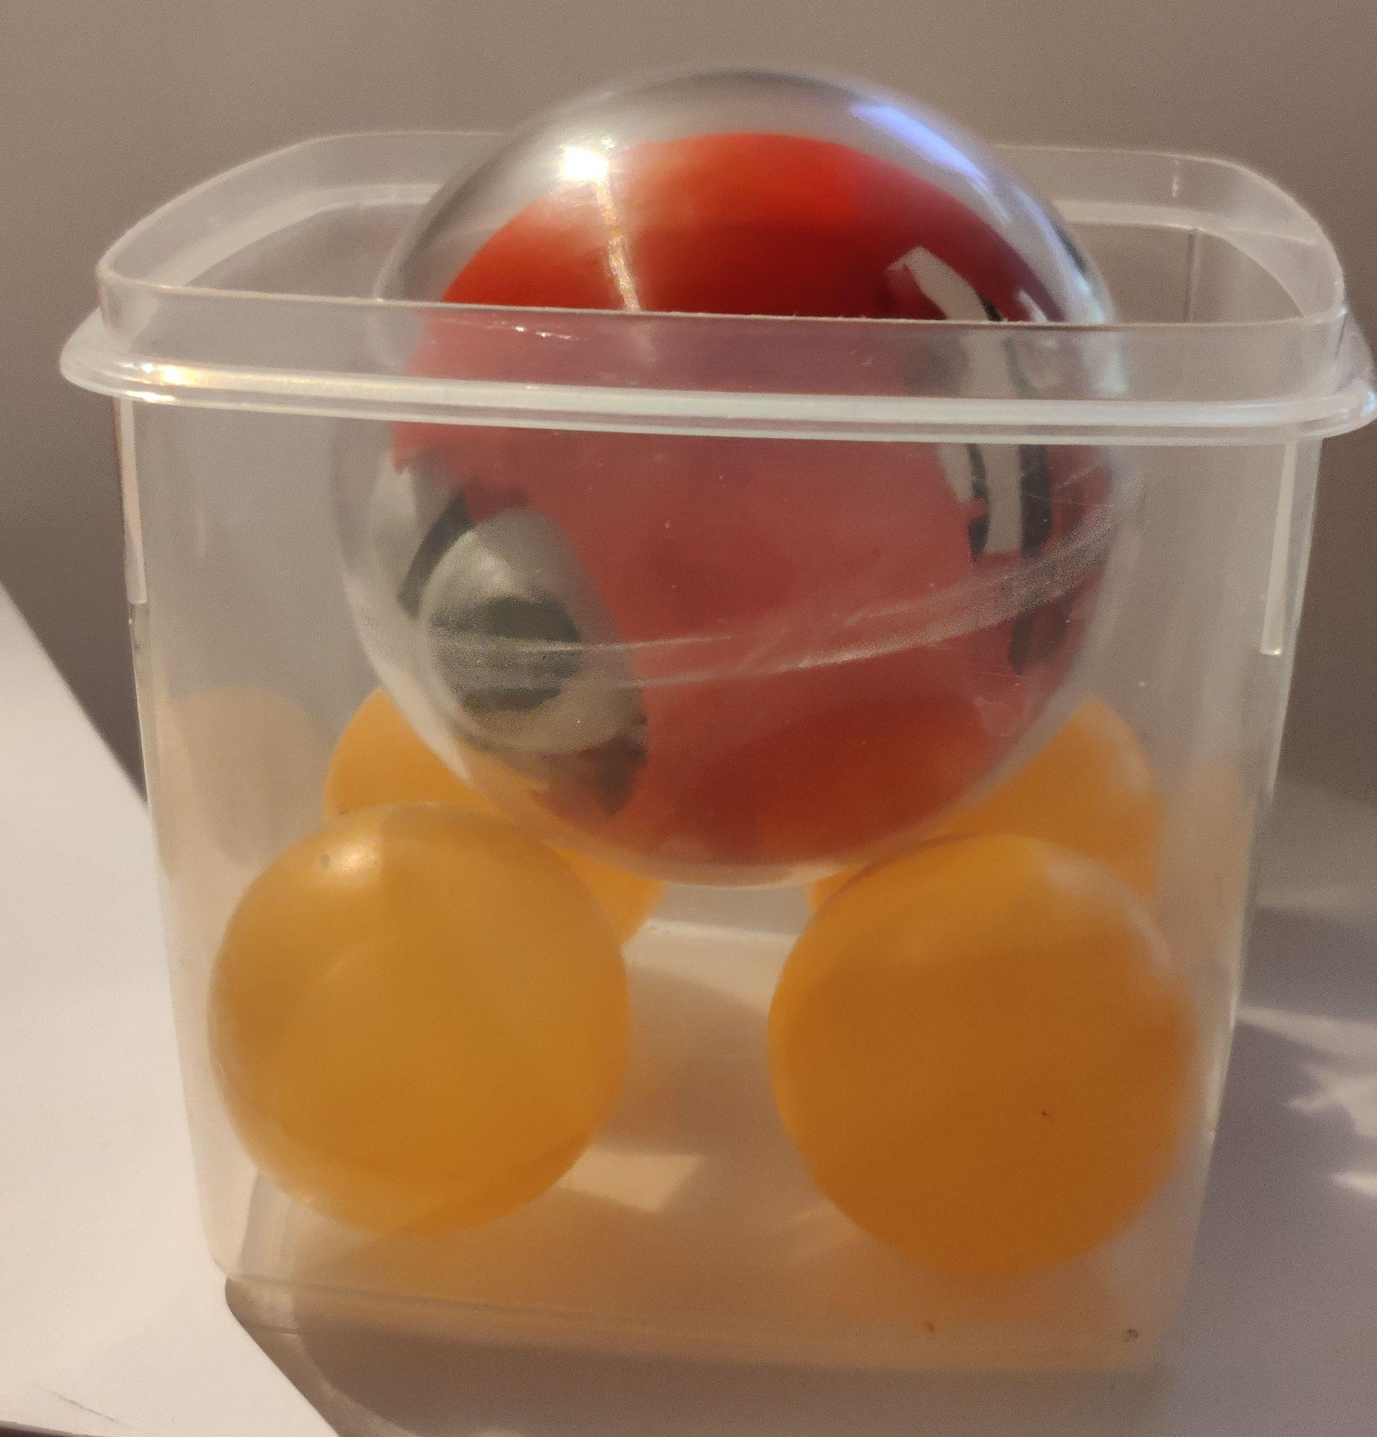
Experiments: Power consumption
1h29min

Slide 30
Future work
Alternative displacement measurements
Ground speed sensors (or mouse sensors)
Optical motor encoders
Low-power GPS
Custom PCB
Centre of Gravity optimization
Commercial gearbox
Different communication protocol
Alternative outer shell: perfectly round and more grip

Slide 31
Conclusion
Extension on Balls for Walls
Remotely Controllable
Connected
Extendable for different Applications

Slide 32
B4W_BB8

